Slide 1
Software Design -
Cross-Cutting Design Principles
Phil Pfeiffer
January 2013

Slide 2
Background: Common Concerns in Design
Design usually treated as multi-phase process
▪ Highest level (architecture)
▪ Somewhat high level (components)
▪ Middle level (classes)
▪ Low level (functions, data structures)
Methodologies for different phases, however, have one key concern in common:
managing system complexity

Slide 3
Managing Complexity in Design
Complexity the key concern
▪ N freely interacting components incur O(N²) relationships
▪ O(N²) taxes people's ability for even small N
All methodologies use divide-and-conquer
▪ Recursively partition logic into smaller entities
▪ system into components
▪ components into classes
▪ classes into functions
▪ Limit interactions to peer entities
Standard focus on effective decomposition
▪ Goals: minimizing scrap and rework, effort of revision
▪ Strategies: seek simplicity, flexibility

Slide 4

Alert!
While much of what follows is common sense, "common sense", as Mark Twain noted, "is the most uncommon commodity available to man".
Listen up!

Slide 5

Major Theme I: Simplicity
There are two ways of constructing a software design.
One way is to make it so simple that there are obviously no deficiencies.
And the other way is to make it so complicated that there are no obvious deficiencies.
- C.A.R. Hoare,
Turing Award Winner;
inventor of Hoare semantics

Slide 6


Simplicity - My Take
Requires clarity
Requires concision
Perfection is achieved, not when there is nothing more to add, but when there is nothing left to take away.
– Antoine de Saint-Exupéry
Author, Le Pétit Prince
Achieving simplicity
1. Through partitioning
  1.1 Getting the pieces right
  1.2 Getting the relationships right
2. Through design of resulting pieces' internals
  2.1 Clear, concise naming
  2.2 Clear, concise logic

Slide 7

1.1 Getting the Pieces Right
Partitioning should allow people to
quickly relate
▪ an application's behaviors
▪ to the logic that produces them
Classic gauge for effective partitioning:
▪ cohesion - relatedness of module elements
Idea due to Larry Constantine, a creator of structured analysis and design
Different considerations for
▪ functions (methods)
▪ classes
▪ components

Slide 8
Function-Level Cohesion
Constantine's hierarchy:
▪ Functional - 1 well-defined task
▪ Sequential - 1 sequence of subtasks for 1 well-defined task
▪ Communicational - 1 set of subtasks for 1 well-defined task
▪ Procedural - 1 sequence of subtasks across 2 or more tasks
▪ Temporal – 1 set of concurrent subtasks across 2 or more tasks
▪ Logical - multiple, superficially related tasks
▪ Coincidental - multiple, unrelated tasks

Slide 9
Function-Level Cohesion:
Functional Cohesion
Functional - the task; the whole task; nothing but the task
▪ Examples:
▪ compute square root
▪ open file
▪ validate dataset
▪ determine if undergrad meets degree requirements
▪ Typical name:
strong imperative verb + specific, singular direct object
Settle for nothing less in your own work ☺
Be aware of the other six, since not everyone does ☹

Slide 10
Function-Level Cohesion:
Sequential & Communicational Cohesion
Sequential - 1 sequence of subtasks for 1 well-defined task
▪ Example: open ETSU undergraduate's data file,
then validate its format
Communicational - 1 set of subtasks for 1 well-defined task
▪ Example: check if student meets intensive course and gen-ed requirements for ETSU undergraduate degrees
Contrasts:
▪ Sequential has "assembly line" aspect ("and then … and then…")
▪ Communicational works on common dataset ("and … and …")
Both reasonably good; neither optimal
▪ Problem: change in workflow may force eventual split, anyway
▪ Advice: split into separate functions up front

Slide 11
Function-Level Cohesion:
Procedural & Temporal Cohesion
Procedural - 1 seq. of subtasks across 2 or more sequential tasks
▪ Example: print diploma for current ETSU undergraduate,
then load record for next undergraduate
Temporal - 1 set of subtasks across 2 or more concurrent tasks
▪ Example: print graduation notice, diploma, and ETSU alumni organization letter for this undergraduate
Similarities:
▪ do tasks for two or more related tasks
▪ created by taking scissors to workflow diagram
▪ access content from two or more distinct domains
Contrasts:
▪ order of execution less important in temporal module
Both are weak: redesign, based on constituent objects

Slide 12
Function-Level Cohesion:
Logical & Coincidental Cohesion
Logical - one set of superficially related tasks
▪ Example: print graduation-related materials
▪ Intent may be to share buffers, code, constants, or parameters
▪ Look for "flag" parameter that selects one of N objects to target.
▪ Typical name: strong verb + vague object (e.g., input/edit/print stuff)
Coincidental - one set of unrelated tasks
▪ Example: do miscellaneous end-of-semester tasks
▪ Typical name: totally vague (e.g., general/miscellaneous/utility module)
▪ From Structured Design, 5.1, Yourdon:
Coincidental cohesion is fortunately rare. It usually comes from lunatics, arbitrary modularlization after coding, and ill-considered maintenance changes to modules with mediocre cohesion.
Both are atrocious; avoid.

Slide 13
Function-Level Cohesion: Summary
▪ Functional: simple, strong names –
concrete, active verb; concrete, direct object
▪ Sequential: multiple verb/object phrases, joined w. "and then" –
reference a common, well-defined object
▪ Communicational: multiple verb/obj. phrases, joined w. "and" – reference a common, well-defined object
▪ Procedural: multiple verb/object phrases, joined w. "and then" –
reference multiple, distinct (but well-defined) objects
▪ Temporal: multiple verb/object phrases, joined with "and" –
reference multiple, distinct (but well-defined) objects;
actions concurrent (e.g., "initialize all", "finalize all")
▪ Logical: strong verb with vague referent
▪ Coincidental: vague name: "general", "misc.", "utility"

Slide 14

Object-Level Cohesion
Several authors,
post-Constantine,
have discoursed on
object (i.e., class) cohesion.
Example: Meilir Page-Jones' characterization of classes
with weak cohesion
▪ Mixed-domain
▪ Mixed-instance
▪ Mixed-role
Page-Jones, Fundamentals of Object-Oriented Design

Slide 15
Object-Level Cohesion: Problems
▪ Mixed-domain: grouping of functions on different domains
▪ e.g.: "real number utility class" - a vendor class with operations on dollars, arctangents, temperatures …
▪ Avoid.
▪ Mixed-instance: grouping of functions that don't apply to all instances of class objects
▪ e.g.: a process class that supported console-mode and windows-mode APIs (e.g., Win32 "CreateProcess")
▪ Avoid.
▪ Mixed-role: grouping of functions that don't apply to all roles that a class object might assume
▪ e.g.: a tree class with wood quality (for furniture) as well as shade quality attributes
▪ Harder to avoid.

Slide 16
Object-Level Cohesion: Naming
▪ For classes, use nouns, possibly qualified.
▪ record, battery, socialSecurityNumber
▪ The "Grand Mistake" (Meyer): structuring a class based on functions rather than objects - e.g.,
▪ parseRecord, chargeBattery, processSSNumber
▪ Exception (Meyer):
"Mixin" classes that describe a structural property should be named with an adjective.
▪ "mixin" - abstract class intended for use in a context that supports multiple inheritance
Bertrand Meyer, Object-Oriented Software Construction

Slide 17
Component-Level Cohesion
▪ Common Use Principle: A component's classes should be used together. If you use one of the classes in a component, you use them all.
▪ Common Closure Principle: A component's classes should be closed together against the same kinds of changes. A change that affects a component should affect all of that component's classes and no other components.
based on http://flylib.com/books/en/4.444.1.165/1/

Slide 18
More on Getting the Pieces Right
Apart from functionally cohesive entities,
a good partitioning should produce the following:
▪ Entities that correlate with concerns clients deem important (analysis entities). This is crucial.
▪ Entities that have elegant implementations.
▪ Entities that promote reuse: i.e., that
▪ expose opportunities for reuse in the current system
▪ create opportunities for reuse in future systems

Slide 19
1.2 Getting the Relationships Right
Key concern: keeping dependencies simple
A depends on B if changes to B affect A
Strategies for simplifying dependencies:
▪ Simplifying patterns of interaction
▪ eliminating circularities
▪ limiting span of interaction
▪ Limiting information exchanged during interaction

Slide 20
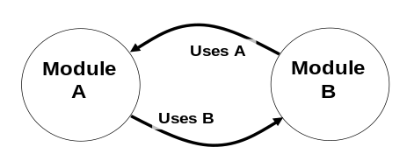
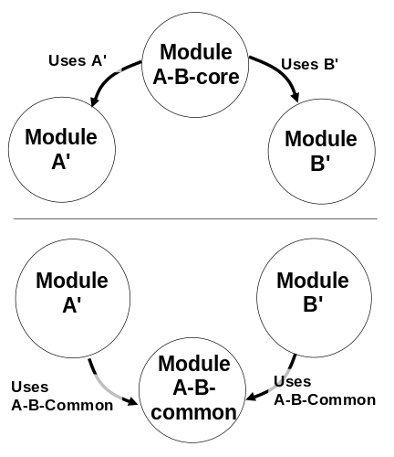
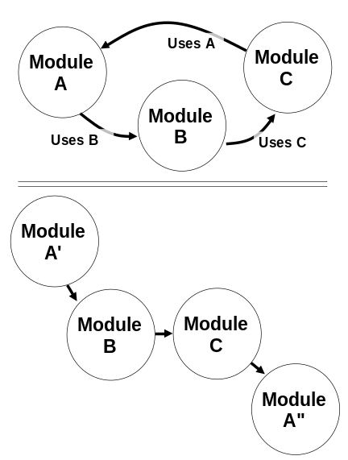
Eliminating Circularities
▪ In a circular relationship,
which entity do you test first?
▪ Best: avoid – reorganize to break cycles
▪ Alternative: weaken dependency w. dumb datasets
▪ Scenario
▪ A – a screen – contains B – a widget
▪ B must know about A: e.g., for "display self"
▪ Strategy
▪ Allow B to query A and store info locally, but
▪ Require B to use A's methods to use info
▪ Advantage
▪ Allows B to be tested separately from A
by instantiating B with null values
John Lakos, Large Scale C++ Software Design

Slide 21
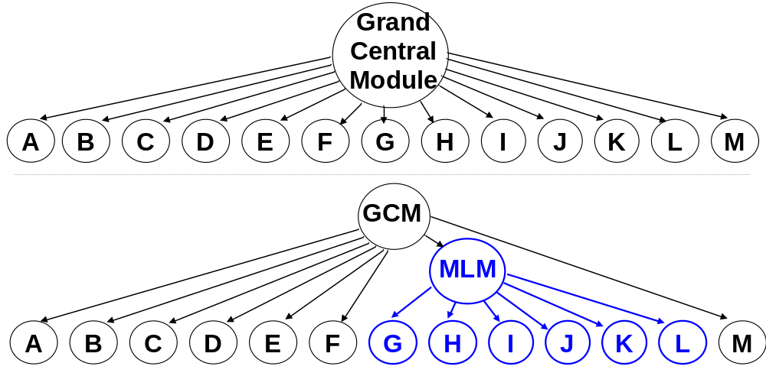
Limiting Span: Horizontal Span
Ability to consider more than 7-9 dissimilar items impeded by limits to human short-term memory
Best practice: limit fan-out at complex item by adding (cohesive) middle-level manager modules
Yourdon, Inc., Structured Design
George Miller, The Psychology of Communication

Slide 22

Limiting Span: Vertical Span (1)
Tramp Data: Too much "up and down" data movement muddies flow of logic
Module 0
calls
calls with item
Module 1
returns item
Module 6
calls
calls with item
Module 2
returns item
Module 7
calls
Module 3
returns item
calls with item
calls
Module 8
returns item
Module 4
calls with item
Module 9
calls
returns item
Module 5

Slide 23
Limiting Span: Vertical Span (1)
Eliminating tramp data with information capture module
Module 0
calls
calls
Module 1
Module 6
calls
calls
Module 2
Module 7
calls
Module 3
calls
calls
Module 8
Module 4
calls
Module 9
calls
stores item
Module 5
Module 10
retrieves item

Slide 24
Limiting Span: Vertical Span (2)
Inheritance is another form of vertical content sharing
Deep inheritance hierarchies are confusing
▪ If D inherits from C, C from B, and B from A, then
▪ …to understand D, you must
▪ …understand how D differs from C
▪ …understand how C differs from B
▪ …understand how B differs from A
▪ …understand A
▪ …to change A, you must consider effect on B, C, and D
▪ …to change B, you must consider effect on C and D
▪ …to change C, you must consider effect on D
Best practice: convert deep is-a relationships to has-a
▪ Subject of design patterns literature (pending)

Slide 25
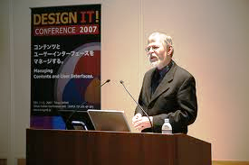
Limiting Information Exchange
Idea: pass information explicitly, based on need to know
Classic gauge for quality of exchange:
▪ coupling - interreliance amongst modules
Notion also due to Constantine

Slide 26
Function-Level Coupling
First four cases: function interface characterizes all sharing
Null - no shared data
Data - sharing of individual items
Stamp - sharing of datasets, incl. items that needn't be shared
Control - sharing of parameters that direct behavior
Last four cases: sharing outside of function interface
External - sharing via persistent store: e.g., file, database, device
Common - sharing via a common area
Global - sharing via global variables
Content - sharing via internal workings of other functions.
When multiple forms of coupling present, worst applies

Slide 27
Null Coupling
No sharing of data: e.g.,
resetFilePointer( ) // for a file API
showLineNumbers( ) // for a text editor
▪ Loosest (best) form of coupling - but not common
▪ Avoid when omitting parameter would create an explosion of methods: e.g.,
setBackgroundColorWhite( ) setBackgroundColorGray( )
setBackgroundColorYellow( ) setBackgroundColorGreen( )
. . . . . .
Data Coupling
Sharing of individual data items, all via interface: e.g.,
solveQuadraticEquation(a, b, c )
generateDiploma( studentName, semester, year, degree )
Loosest commonly occurring form of coupling

Slide 28
Stamp Coupling
Datasets / data structures shared, all via interface: e.g.,
makeNextMove( currentChessboard )
generateDiploma( studentRecord )
Reasonably clean; still, potential problems:
▪ Restructuring shared dataset could force changes to caller logic
▪ Presence of unneeded data can obscure function's operation
▪ Passing data by reference exposes it to inadvertent modification
Control Coupling
Use of "do this" parameters or "do that" return values: e.g.
solveQuadratic( a, b, c, throwExceptionIfImaginaryResult_flag )
checkAccountStatus( studentRecord, purgeOnNonPayment_flag )
status = printDiploma( studentRecord )
Avoid, when possible
▪ Split client routines into "set state" and "do task" routines
▪ Be particularly wary of boolean parameters
▪ Status return values unavoidable in languages that lack exceptions

Slide 29
Hybrid Coupling
▪ Special case of stamp coupling that shoehorns multiple meanings into a single datum: e.g.,
▪ values in [0000-0999, 1000-1999, 2000-2999, 3000-3999]
denote 1st, 2nd, 3rd, and 4th yr courses, respectively
▪ Often deteriorates into control coupling, due to use of special status values known as sentinel values: e.g.,
▪ values in [-256, -1] are error codes;
values in [0, 255] are ASCII chars
▪ Introduced in '70's for efficiency - i.e., allowing results to be returned as single values in single registers
Avoid.

Slide 30
Coupling Outside the Interface
External coupling: via persistent public data stores -
databases, files, environment variables
Common coupling: via common areas - blocks of shared data explicitly imported into program modules
▪ named for FORTRAN construct of same name
Global coupling: via global variables
▪ known by some - not my instructors - as common coupling
Content coupling: via implicit assumptions
▪ sharing of literals (i.e., compile-time constants)
a.k.a. "premature binding" (http://kkspot.110mb.com/Data/CS/sda/module%202.1%20.ppt#297,20)
▪ branching into a second function's code
▪ referencing or changing a second function's local data
▪ dynamically changing a second function's statements
Avoid. Content coupling particularly horrid.

Slide 31
Coupling for Classes, Components
Classes: selected treatments
▪ Subclass coupling
▪ Coupling between a class and its subclass (normal in OO)
▪ Temporal coupling
▪ Grouping of functions in a class based on concurrent execution, time, rather than on commonality of domain
▪ Efferent coupling
▪ Coupling between a class and externally defined data type;
used to measure of a class's focus or brittleness
Components
▪ One treatment at http://soaevolution.blogspot.com/2007/08/cohesion- coupling-and-soa.html
▪ Idea: use of public endpoints, messages for communication provides looser coupling

Slide 32
2.1 Effective Naming
Good reusable software is software that provides the right functionality … under the right names.
– Bertrand Meyer, Object-Oriented Software Construction
The hardest thing about choosing good names is that it requires good descriptive skills and a shared cultural background.
– Tim Ottinger, Ottinger's Rules for Variable and Class Naming

Slide 33
Choosing Clear Names
▪ Choose names that are accurate and precise: i.e., that
▪ reveal their entity's purpose: e.g., sum (not s)
▪ do so correctly: e.g., set for unordered content (not list)
▪ meet standard usage: e.g., dependentDeduction (not cash4Kids)
▪ Choose pronounceable names: i.e.,
▪ timestamp and previousPassword (not ymdhms and prvsPswd)
▪ Name actions using concrete verb-direct object pairs: e.g.,
▪ validateRecord, rechargeBattery, getSocialSecurityNumber
Exception: class "getter" methods often omit get
▪ Name classes using nouns.
▪ record, battery, socialSecurityNumber
Exception: "mixin" classes for multiple inheritance that define qualities
Based on Ottinger's Rules for Variable and Class Naming, www.objectmentor.com/resources/articles/Naming.pdf
Based in part on Ottinger's Rules for Variable and Class Naming, www.objectmentor.com/resources/articles/Naming.pdf

Slide 34
Choosing Concise Names
▪ Limit name content to essential descriptions of the referent's purpose: e.g.,
▪ product (not productInfo or productData)
▪ description (not psz_description, m_description, etc.)
Does anyone here still use Hungarian notation?
Who knows its origin – and rationale?
Based on Ottinger's Rules for Variable and Class Naming, www.objectmentor.com/resources/articles/Naming.pdf

Slide 35

2.2 Effective Logic
Debugging is twice as hard as writing the code in the first place. Therefore, if you write the code as cleverly as possible, you are, by definition, not smart enough to debug it.
– Brian Kernighan
(co-developer, C, AWK, Unix)

Slide 36

Programmers waste enormous amounts of time thinking about, or worrying about, the speed of noncritical parts of their programs, and these attempts at efficiency actually have a strong negative impact when debugging and maintenance are considered.
We should forget about small efficiencies, say about 97% of the time: premature optimization is the root of all evil.
Yet we should not pass up our opportunities in that critical 3%.
– Donald Knuth
(developer, TeX;
author, The Art of Computer Programming)

Slide 37
Clarity in Logic: Constants
Symbolic Constant principle (Meyer):
Do not use a manifest constant, other than the zero elements of basic operations, in any construct other than a symbolic constant declaration.
Examples:
▪ workDaysPerWeek (not 5)
▪ absoluteZero (not -459.6)
Examples of zero elements:
▪ 0 and 0.0 (+, -); 1 and 1.0 (*, /); "" (string operators);
0 (initial array index, Python); 1 (array increment)
Possible exception:
▪ self-describing messages that are used once

Slide 38

Clarity in Logic: Interfaces
[Interfaces] should have a small number of arguments. No argument is best, followed by one, two, and three. More than three is very questionable and should be avoided with prejudice.
– Robert C. ("Uncle Bob") Martin,
President and CEO, ObjectMentor
Alternative:
▪ multiple, small function calls, including
▪ calls to set state
http://www.informit.com/articles/article.aspx?p=1375308

Slide 39
Clarity in Logic: Algorithms
First Rule Of Optimization - Don't.
Second Rule Of Optimization - Don't... yet.
Third Rule of Optimization - Profile before optimizing
http://c2.com/cgi/wiki?RulesOfOptimization
▪ Optimization typically requires additional logic: e.g.,
▪ more sophisticated strategies for accessing data
▪ cacheing of intermediate results
▪ Extra logic makes program harder to write, read
Advice:
▪ In absence of known issues, use straightforward logic first

Slide 40

Concision in Logic
A programming language is low level when its programs require attention to the irrelevant.
– Alan Perlis
1st Turing Award Winner; developer
of Algol, 1st block-structured language
Concision achieved by coding with expressive (i.e., powerful) operators
▪ Loops (instead of gotos)
▪ Aggregate (instead of scalar) operators
▪ sequences (map, reduce, expand)
▪ maps (keyed lookup)
▪ trees (XPath expressions)

Slide 41
Concision in Logic
▪ Principle of "once and only once":
Eliminate duplicate instances of behavior by merging them or replacing them with a suitable abstraction.
Note: Martin Fowler (Refactoring) recommends possibly relaxing principle for logic that's used exactly twice.
▪ Single choice principle (Meyer):
Whenever a software system must support a set of alternatives, one and only one module in the system should know their exhaustive list.
These principles are as much about reducing coupling as assuring concision.

Slide 42
Concision and DRY
DRY = "Don't Repeat Yourself"
  Another formulation of "once and only once"
  Every piece of knowledge must have a single, unambiguous, authoritative representation in a system.
  Proponents differentiate from "once and only once" by stressing emphasis on "single" and "authoritative"
  (cf. http://c2.com/cgi/wiki?DontRepeatYourself)
At base, a proscription against content coupling
  Repetition = coupling based on assumption of consistency between repeated information
  High coupling = a serious ill, due to impact on maintainability
May require automation to generate artifacts that depend on single, authoritative source
  Example: derivative schemas from master schema

Slide 43
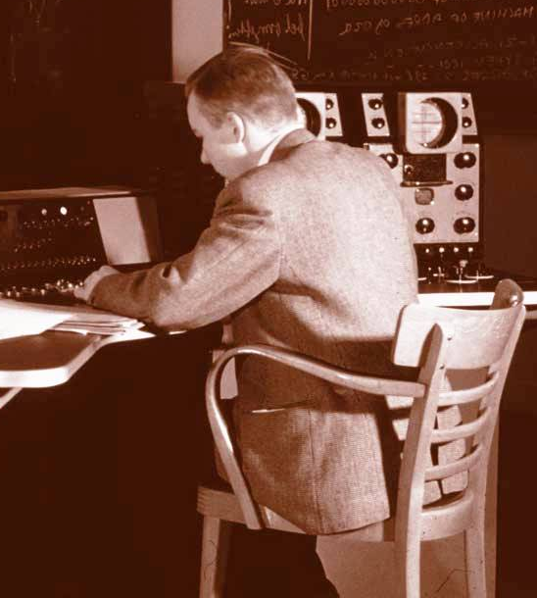

Clarity, Concision, and Consistency
A good architecture is consistent in the sense that, given a partial knowledge of the system, one can predict the remainder. We believe that consistency underlies all principles of quality.
– Gerritt Blaauw and Frederick Brooks
▪ Chief architects, IBM 360;
▪ Authors,
Computer Architecture: Concepts and Evolution

Slide 44
Opportunities for Consistency
Naming
▪ standardizing conventions for capitalizing names, writing compound names
▪ standardizing terms for types of operations, data
Functionality
▪ standardizing cross-cutting concerns: i.e.,
▪ interface look-and-feel
▪ message formatting
▪ data type management (e.g., strings)
▪ anomaly management (e.g., exceptions)

Slide 45
Major Theme 2: Flexibility
Often in conflict with major theme 1: simplicity
▪ Working beyond customer requirements a gamble
▪ Certitude of software evolution, however, makes working to customer requirements another gamble
Strategy for choice: risk analysis
▪ Compare
▪ likely cost of generalizing design
▪ likelihood of change * likely cost of change
▪ If cost of generality is low, relative to likely cost of recovering from change, choose more general strategy

Slide 46
Best Practice: the 0, 1, or ∞ Principle
When considering how to support multiple instances of an element, plan for one of three situations:
▪ Supporting no instances
▪ Supporting exactly one instance
▪ Supporting arbitrarily many instances
Examples
▪ Treating buildings as having arbitrarily many rooms instead of (say) a max of 500
▪ Designing an "employee" abstract class that supports arbitrarily many job role subclasses
instead of designing N job role classes
For classes, known as dependency inversion principle

Slide 47
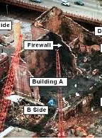
Best Practice: Isolating Risk
Isolate likely areas of functional instability with interfaces that abstract the functionality's key concerns: e.g.,
▪ Platforms
▪ Data exchange formats
▪ User interface designs
Concern: contain "damage" to other parts of implementation due to change

Slide 48
If You Can Afford It: Configurability
Idea: support table-driven parameterization of application behavor, based on content of persistent store, rather than dialogue-driven or hard-wired parameterization
▪ i.e., replacing hard-wired control with data-driven control
Advantages:
▪ eliminate dependency of expert user on programmer
▪ eliminate or minimize (re)development effort required to modify application behavior
Disadvantages:
▪ often time-consuming to implement
▪ potential difficulty of devising user-friendly way of initializing, modifying these configurations

Slide 49
Summary of "Unifying Principles"
Strive for clarity, concision in partitioning
▪ High cohesion (ideally, functional)
▪ Methods: concrete verb / direct object naming
▪ Classes, components: noun naming
▪ Low coupling (ideally, null or data)
Strive for clarity, concision in partitioned entities
▪ Clear naming
▪ Limited interface complexity (ideally, 0-3 parameters)
▪ Avoidance of optimization (unless requirements mandate it)
▪ Operations on aggregates (where feasible)
▪ "Once and only once" distribution of functionality
Achieving flexibility
▪ 0, 1, or ∞
▪ Isolating instability behind interfaces
▪ Data-driven control (where feasible)

Slide 50
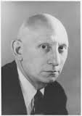
The Last Words
Simplicity does not precede
complexity, but follows it.
Fools ignore complexity.
Pragmatists suffer it.
Some can avoid it.
Geniuses remove it.
- Alan Perlis

